Slide 1

KHANA KA KHAJANA
Project submitted to the
SRM University – AP, Andhra Pradesh
for the partial fulfilment of the requirements to award the degree of
Bachelor of Technology/Master of Technology
In
Computer Science and Engineering
School of Engineering and Sciences
Submitted by
Vishal Kumar Singh
[ AP20110010042]

Slide 2
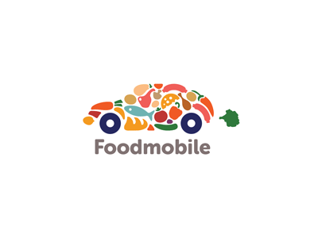



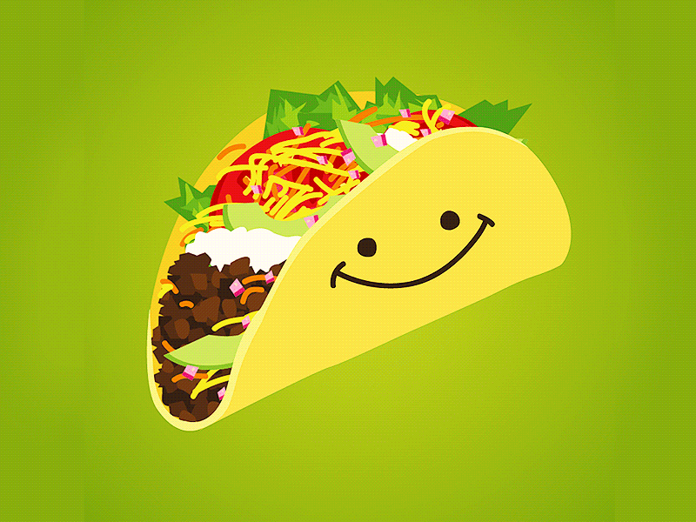
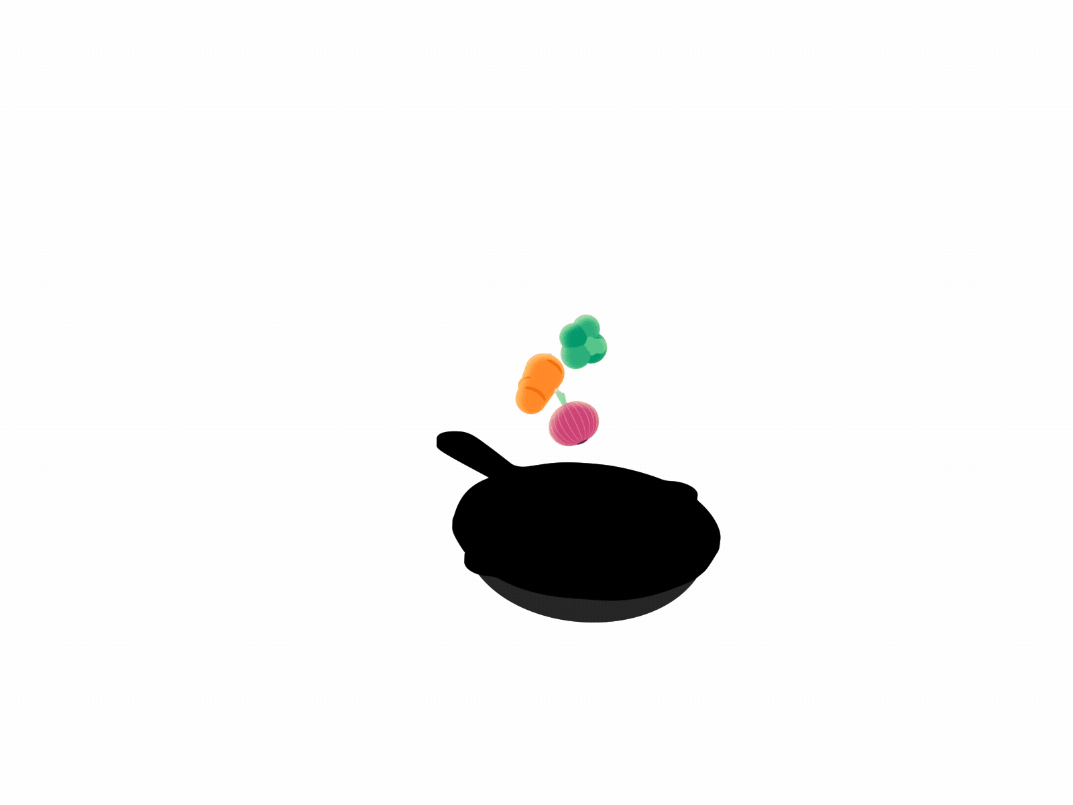
Data Model
Requirements and Goals of the System
Main actors in our system
Customers/consumers
Restaurant (Merchant)
Doordashers (Drivers)
Food chef

Slide 3
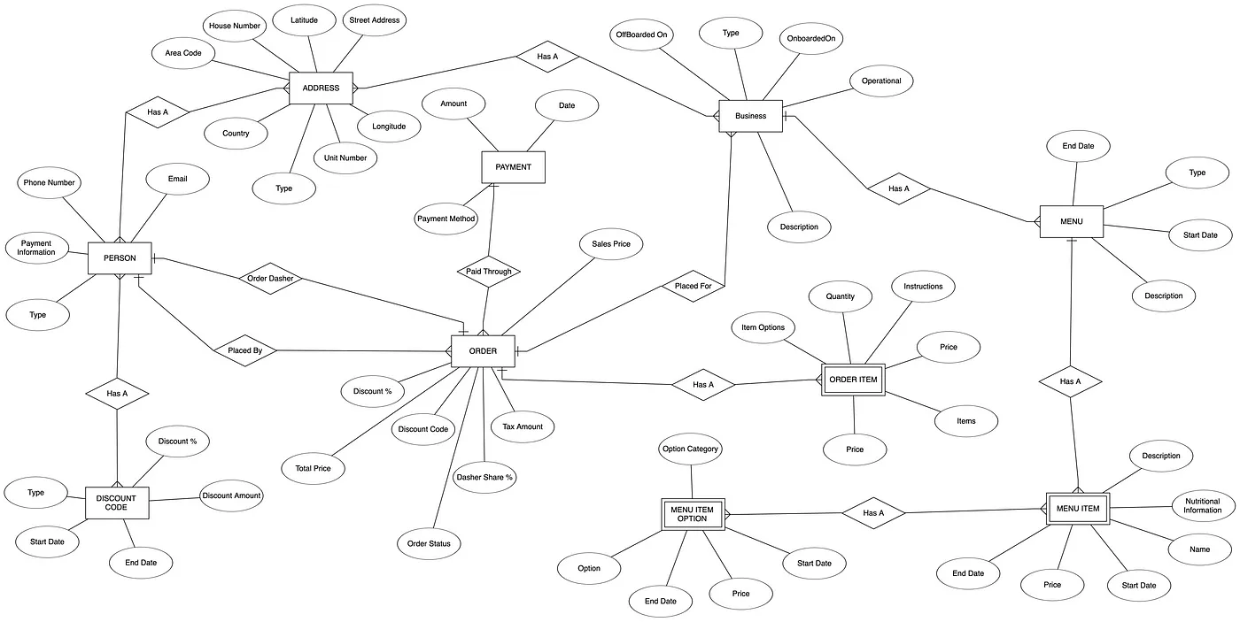
A sample Entity Relationship Diagram for the application:

Slide 4
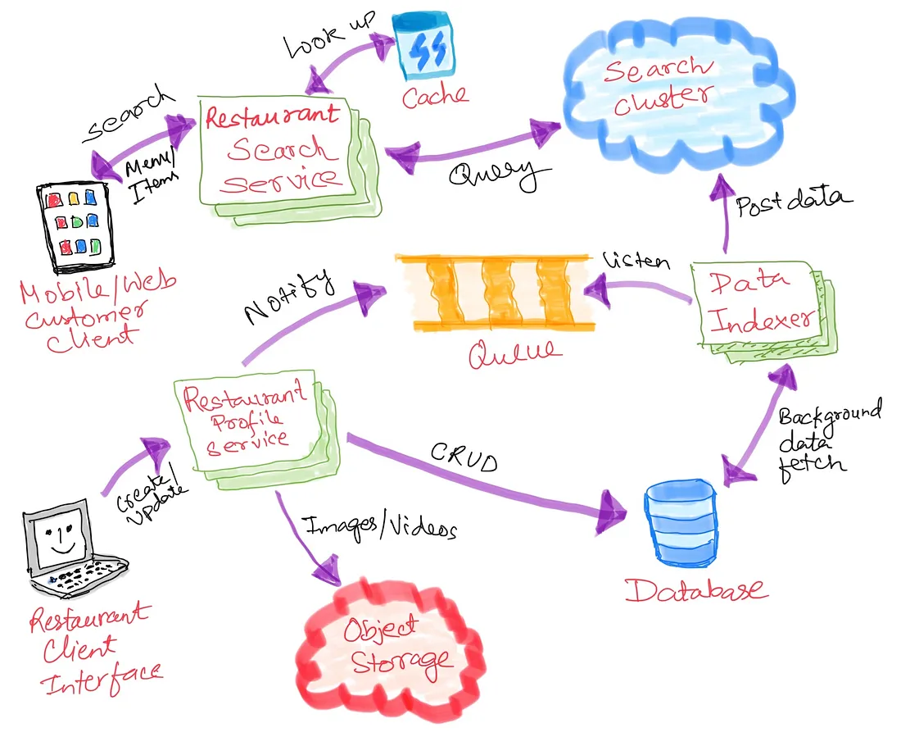
Restaurant Profile Service
Doordasher Dispatch Service
The search ecosystem will look like the below :
This service will be used to accomplish use-cases relating to a doordasher. A doordasher will be able to:
View pick-up orders from a list, that they can accept.
Accept an order.
View past orders that they have accepted.
View the customer information from the order in case they need to communicate with them about delivering, or inform the restaurant about any problem that stops them from picking up or delivering the food.

Slide 5
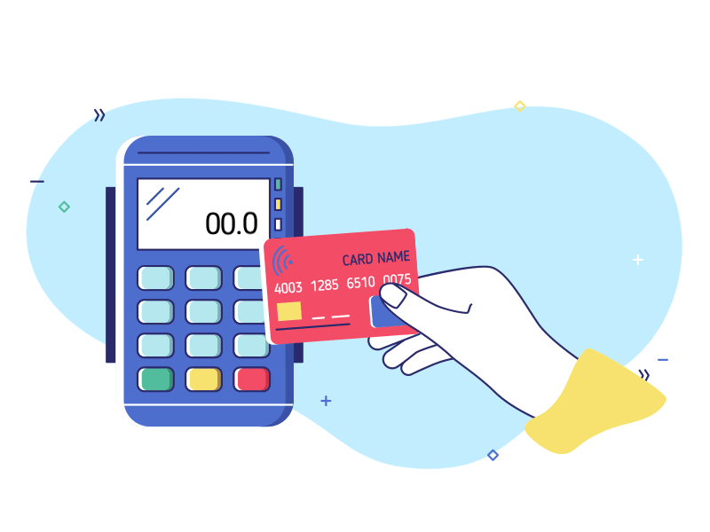
External Payment Gateway
This component can interface with popular payment gateways like Amazon Payments, We Pay, PayPal, ApplePay, or individual Credit Card providers like Amex, Visa, Mastercard, etc. The Order Service will interact with this component to ensure the payment is done at the time of confirming the order. The interaction should be synchronous in nature.

Slide 6
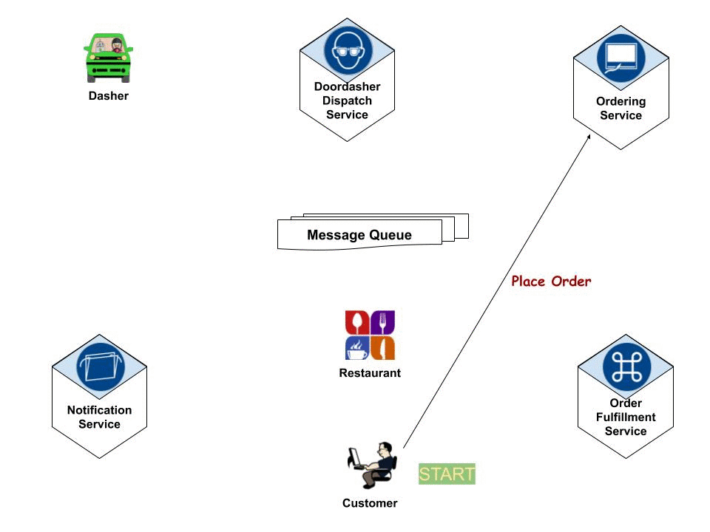
Service
The customer: about various stages of the order, for example, the order was placed successfully, the restaurant has accepted the order, or, door dasher has picked up the order and is on his/her way to deliver it.
The restaurant: an order was placed, a door dasher is assigned to the order, or the door dasher is on his/her way to pick up the order.
The door-dasher: that orders are waiting in their queue for their acceptance, or that the order is ready to be picked up, or that the order they have accepted is being delayed, etc.
Order fulfillment Workflow

Slide 7
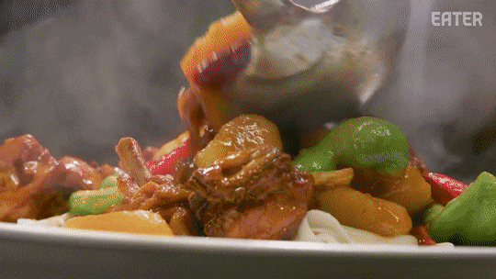
System APIs Some of the customer-facing APIs exposed by the various services:
Ordering food:
search (array of search terms)
addToCart(menu-item)
order(cart)
status(orderId)
retrieveOrder(orderId)
cancelOrder(orderId)

Slide 8
Data Partitioning
As the data grows, it becomes impossible to store all the data in just once instance of the database. Restaurant data can be partitioned based on:
Area code
RestaurantId
Menu items/cuisines/dishes
Combination of area code & restaurantId
Each of the above partitioning schemes has its own benefits and disadvantages. The strategy needs to be well thought out considering all possible side effects and performance improvements before implementing it.
Conclusion
System design interviews are very challenging and thought-provoking and really gives the interviewer a sneak peek into the technical acumen of the interviewee. The best way for preparing for this kind of interview is to start enjoying designing big popular day-to-day applications. Thinking about millions of users, huge datasets, points of failures, transactions, and so forth. I hope this discussion gives you some ideas about how you could go about tackling such interviews. Educative.io has several examples and this post, in part, is influenced by some of the examples presented there.

Slide 9
References:
Wikipedia
Kafka Architecture
Educative.io — Grokking the System Design interviews.
How to add a Redis caching layer to your Elasticsearch queries.
Keeping Elasticsearch in sync
Disclaimers:
This is exclusively my personal design exercise and only for demonstration purposes. I am not affiliated to DoorDash in any way.
The design and the views expressed here are my own and are not from my employer.

Slide 10
BIG thank you!

